Slide 1

SNTI final project submission
TOPIC – INVENTORY FORECASTING
NAME – ABHISHEK MAHATO REF NO – VT20221076
C.v. Raman global university

Slide 2
Acknowledgement
I Abhishek Mahato of C.V. Raman Global University (VT20221076) would like to thank my guide Mr. Gautam Yadav sir for his immense support throughout our project.
Your leadership and knowledge helped us complete this project successfully, we are grateful to have had the privilege of learning from a wonderful teacher such as yourself!
Thank you sir for all of your guidance throughout my work on this project including advice and support when needed!

Slide 3
Source of data
The source of data i.e. the dataset provided is a not under any NDA(Non-disclosure Agreement).
A non-disclosure agreement (NDA) is a legally binding contract that establishes a confidential relationship. The party or parties signing the agreement agree that sensitive information they may obtain will not be made available to others. An NDA may also be referred to as a confidentiality agreement.

Slide 4
Aim
AIM - We have been given 10 questions to perform in the tableau and create dashboards to answer those questions using a given dataset using tableau.
Q1.What is the total inventory?
Q2. Top 10 stores as per cost.
Q3. Top 10 area with lowest inventory.
Q4.Which product needs there with more inventory?
Q5. What are the product that may go in stockout?
Q6. Inventory on world map.
Q7. Filter for area and city.
Q8. Running sum vs as on inventory for each city.
Q9. Stores that should be rewarded for their good work.
Q10. Total sales for each store.

Slide 5
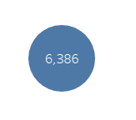
TOTAL INVENTORY
The total inventory of all the shops is calculated to be a total of 6386.
It Has been portrayed by sum(Quantity Available) in the size section and grouping the area in putting it into the colour section.

Slide 6
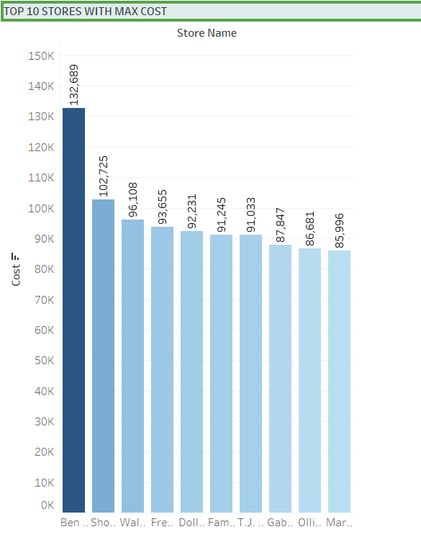
Top 10 stores as per cost
Here the top stores which has max cost as per their retail price has been shown in the graph.
It has been displayed by sum(cost) in the rows section and store name in the column section and sorting it in descending order to find the top 10 stores.
As displayed in the dark blue is the max cost store which is ben Franklin and following it are the rest.

Slide 7
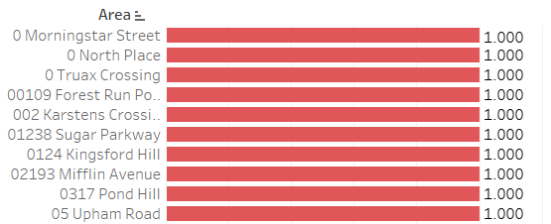
Top 10 area with lowest inventory
Here the top 10 area which has the minimum inventory has been displayed.
It has been portrayed through the sum(Quantity available) in the column section and the area in the rows section.
As depicted in the graph top 10 area which has the lowest inventory are shown in red all have 1.0 quantity of inventory.

Slide 8
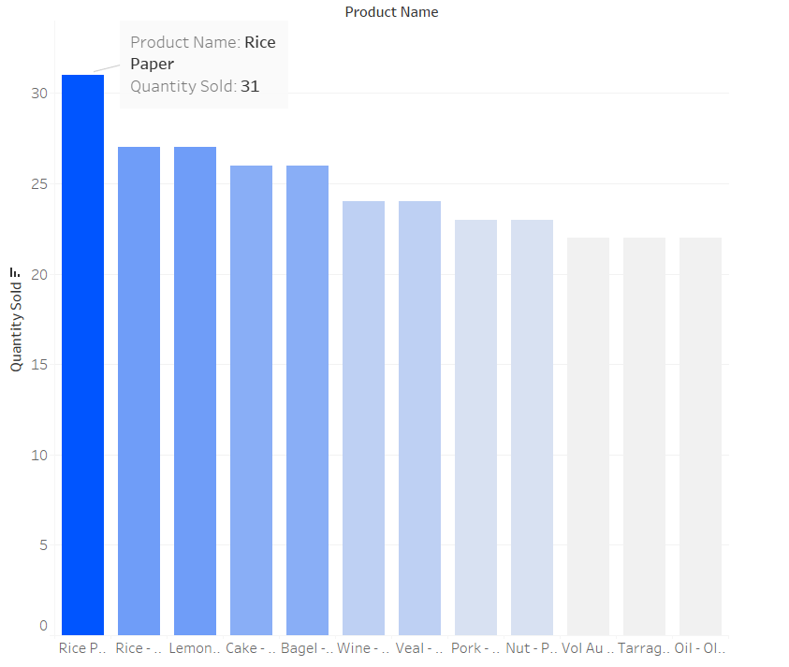
Products WHICH needs to be there with more inventory
Here the products which have the highest sales have been shown in the graph. This is because it would be more appropriate to refill them first such that sales of the product don’t get affected.
It has been depicted by the sum(quantity sold) in the column section and the product name in the rows section and sorting in descending order.

Slide 9
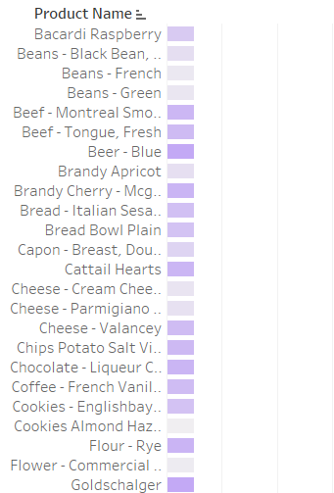
Products that may go stockout
Here we have displayed the products that may go stockout due to high sales of that product.
It is been simply depicted by the sum(quantity available) in the columns section and the product name in the rows section and sorting it in ascending order.

Slide 10
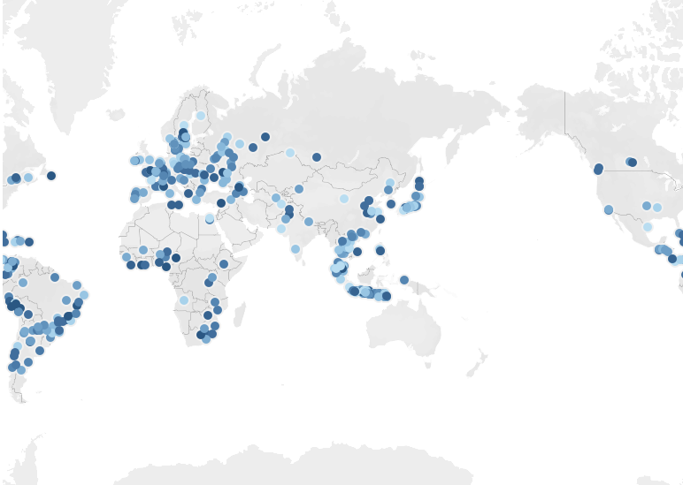
Inventory on world map
Here we tried to depict the display of the whole inventory on the world map.
The darker the circles are higher the quantity concentration present and the lighter the color lesser the quantity available.

Slide 11
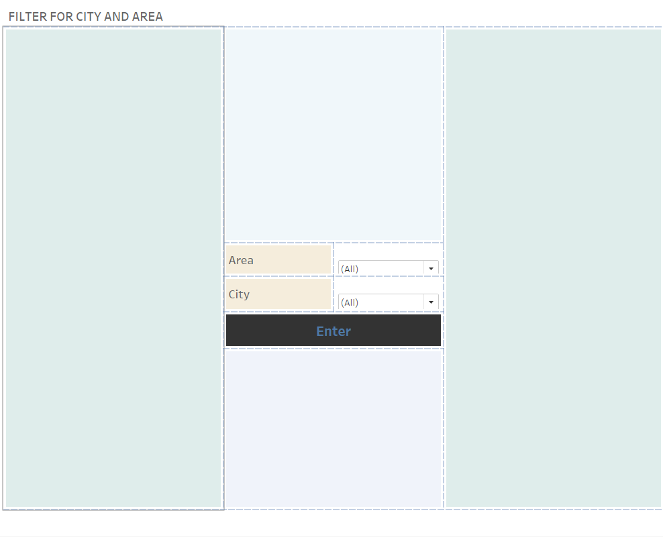
FILTER FOR AREA AND CITY
Here we have provided filters for area and city. The client can select any particular data of the area or city that he needs to analyze.
We have added a navigation button(enter) which will directly direct to the desired dashboard with provided filter data.

Slide 12
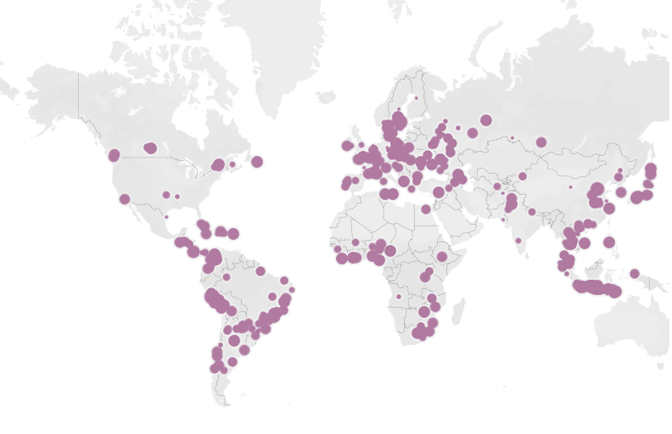
Running sum vs as on inventory for each city
A running sum is the summation of a sequence of numbers which is updated each time a new number is added to the sequence, by adding the value of the new number to the previous running total.
We have a running sum on the inventory(quantity available) for each city in the world map.

Slide 13
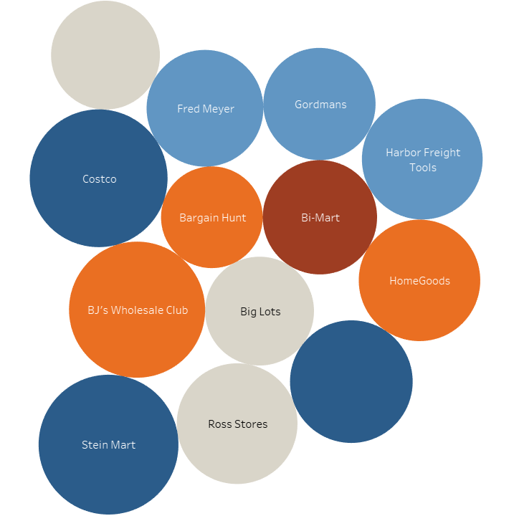
Stores that should be rewarded for their good work
Stores that should be rewarded for their good work are the stores that have their individual highest sales.
The Blue color shows the stores that have highest sales and should be rewarded
Such as Costco and Stein Mart.

Slide 14
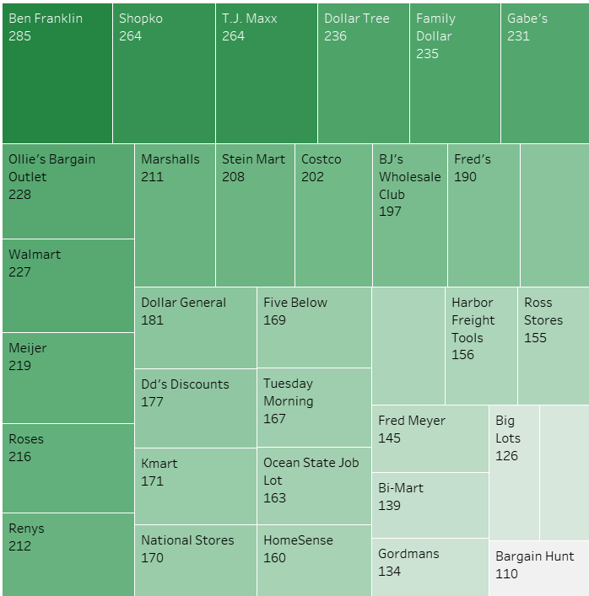
TOTAL SALES FOR EACH STORE
Here we have simply depicted the total sales for each store.
The darker the color greater their sales and gradually decreases as lightens.

Slide 15
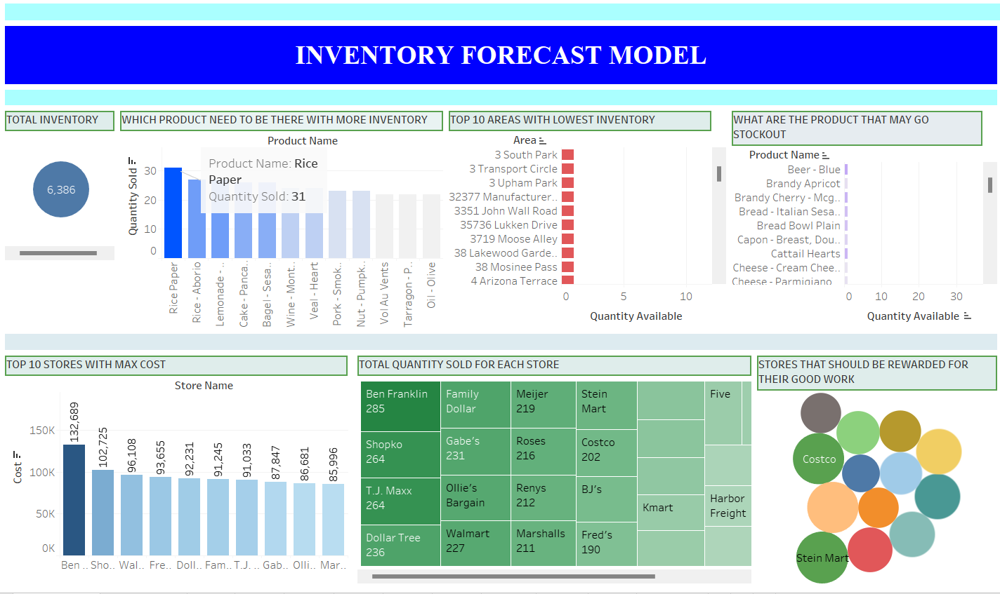
Final dashboards

Slide 16
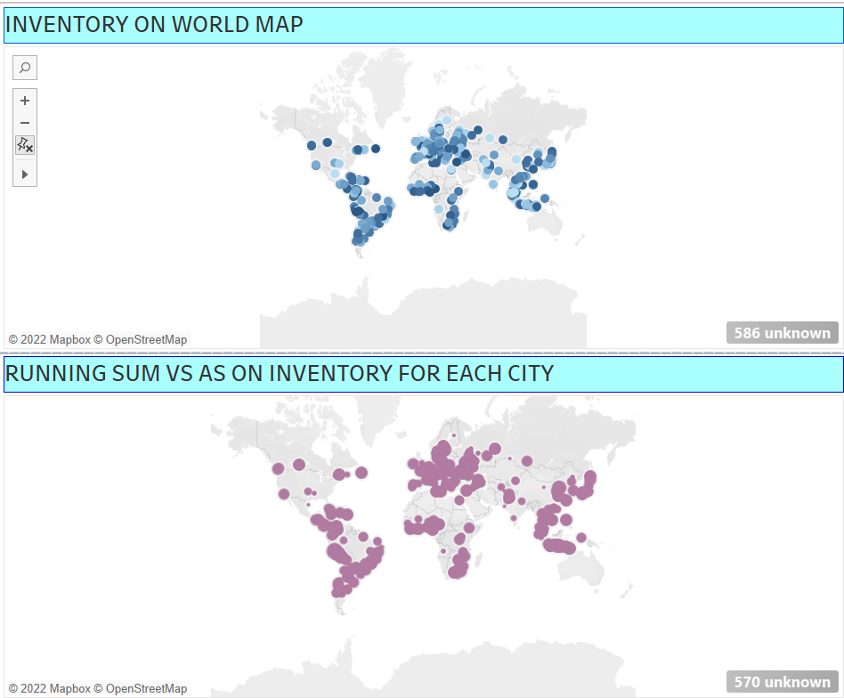

Slide 17
conclusion
This project mainly focused on inventory forecasting which is the practice of using past data, trends, and known upcoming events to predict needed inventory levels for a future period.
We used data analysis to identify patterns and trends to adapt to dynamic conditions and meet customer demand.
Created dashboards in tableau for data visualization and representation using its various features.

Slide 18
Thank you!

